Slide 1
Final Presentation
Heston Implementation for Zynq with Vivado HLS
Group 14: 陳柏帆 張問寬

Slide 2
Outline
Project Introduction
Motivation
Random Number Generator
Heston Model
System Introduction
Code Base
Block Diagram
Target Performance
Computation Complexity
μ-archi. & Optimization
Mersenne Twister
ICDF
Heston
Implementation on Zynq

Slide 3
Outline
Introduction to the system
Motivation
Random Number Generator
Heston Model
Block Diagram
Optimization
Mersenne Twister
ICDF
Heston
Implementation on Zynq

Slide 4
Project Introduction

Slide 5
Motivation
To determine the pricing of an option, financial institutes need to estimate the price of the asset after a certain period.
Several mathematical models are presented, but few have closed form solutions.
Numerical methods are more common but computationally expensive. This work aims to accelerate the computation of the numerical solution of Heston model.

Slide 6
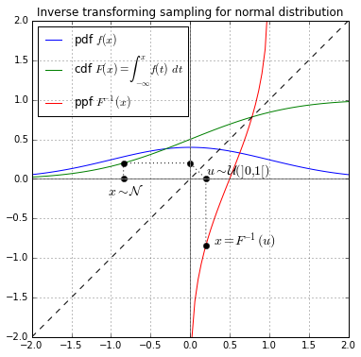
Random number generator
Normal distribution is preferred, but uniform distribution is easier to generate, i.e. Mersenne twister.
Use the inverse CDF to map uniform distribution to normal distribution.
In practice, inverse CDF is divided into segments, and we use polynomial to approximate each segment.

Slide 7
Heston model
In finance, the Heston model, named after Steven Heston, is a mathematical model describing the evolution of the volatility of an underlying asset.
It is a stochastic volatility model: such a model assumes that the volatility of the asset is not constant, nor even deterministic, but follows a random process.

Slide 8
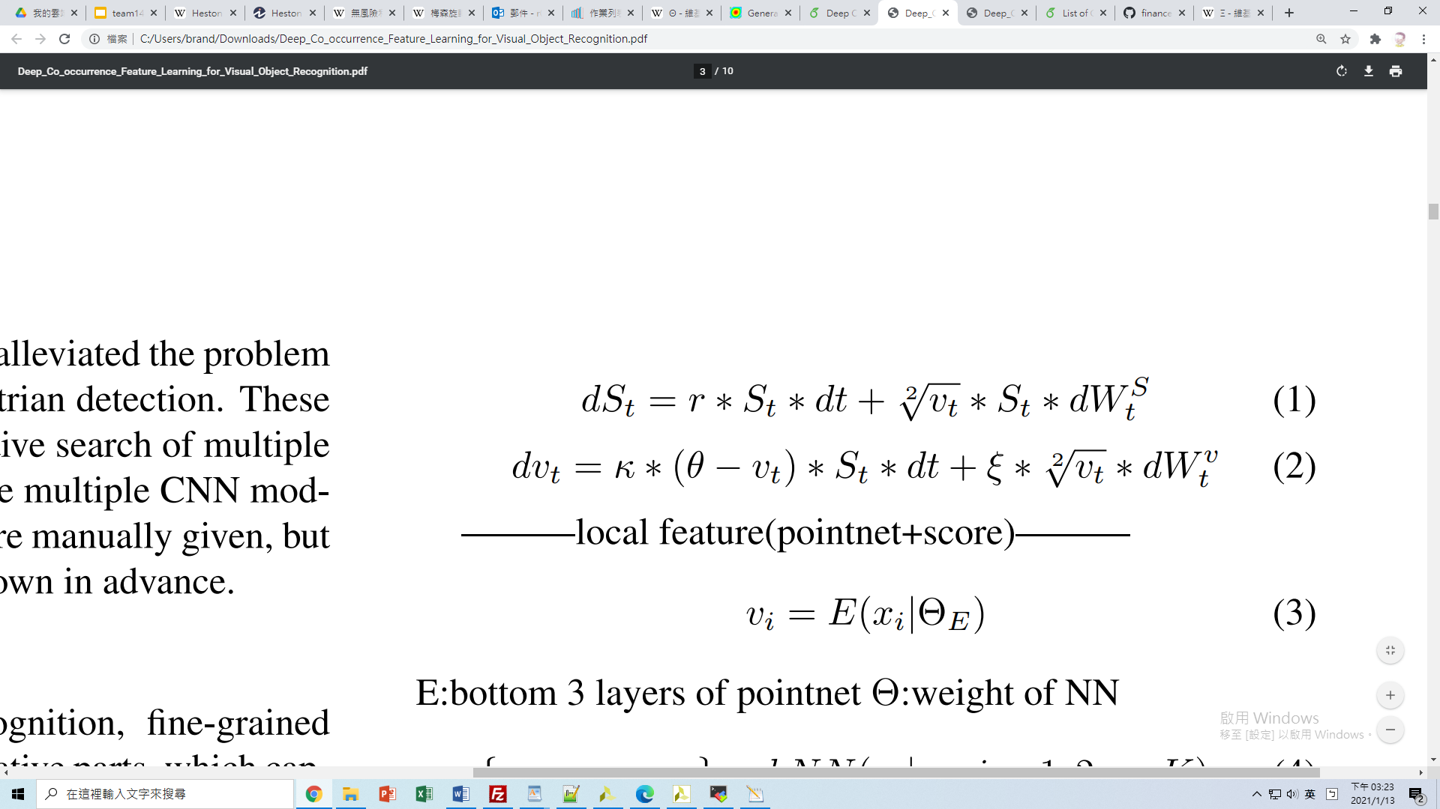
Heston model - terminologies
r : interest rate of an risk-free asset
St: price of the asset at time t
dt: interval between each step
vt: volitility, describes how drastic the price fluctuates
W: a random process

Slide 9
Heston model - terminologies
θ: long term average volitlity
K:reversion rate, how fast the volatility move towards theta
ξ:volitility of volitility, describes how drastic the volitility fluctuates

Slide 10
Heston model - implementation
After repeating (1) and (2) for a given step count, we have the final price of the asset for 1 simulation path.
The price we have, however, is not accurate, for the RNG differs each time. We need multiple simulation paths to get an average price close to the answer.
Different simulations are not correlated, and thus FPGA can be used to do multiple simulations at the same time.

Slide 11
System Introduction

Slide 12
System Introduction
HLS code from tukl-msd/finance.zynqpricer.hls
system flow (SW/HW Partition)
SW(Pynq)
HW(Heston Engine)
Argument
Passing
Mersenne Twister
ICDF
Antithetic
Heston
Price Output Receiving

Slide 13
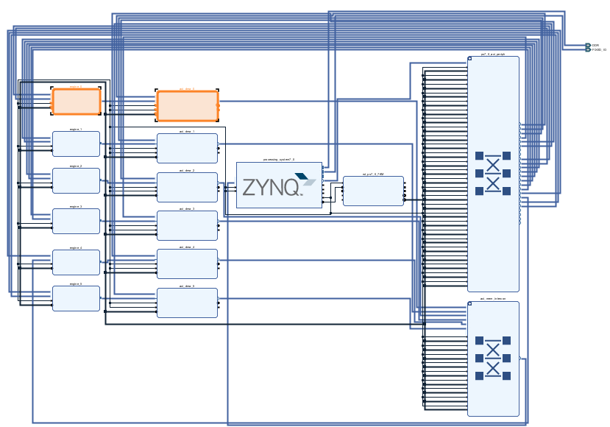
Block Diagram of the System
Supports up to 6 engines.

Slide 14
Spec & Complexity
Spec
1.04e+07 steps/seconds, CPU computation
5.78e+08 steps/seconds ≌ 6 engines*100MHz, FPGA accelerated
Computation Complexity
O(simulation_count * step_count_per_simulation)

Slide 15
System Introduction - Summery
Mersenne twister and ICDF generate a gaussian random number
Antithetic adds in a negative version of each input random number, and thus doubles the data rate. This helps the simulation to converge faster.
Using the generated random numbers, heston module estimates the final price.
Parameters are initialized through axilite.
Each engine does 10000 simulations and returns 10000 final prices through AXI stream.
Use multiple engines to do parellel computation.

Slide 16
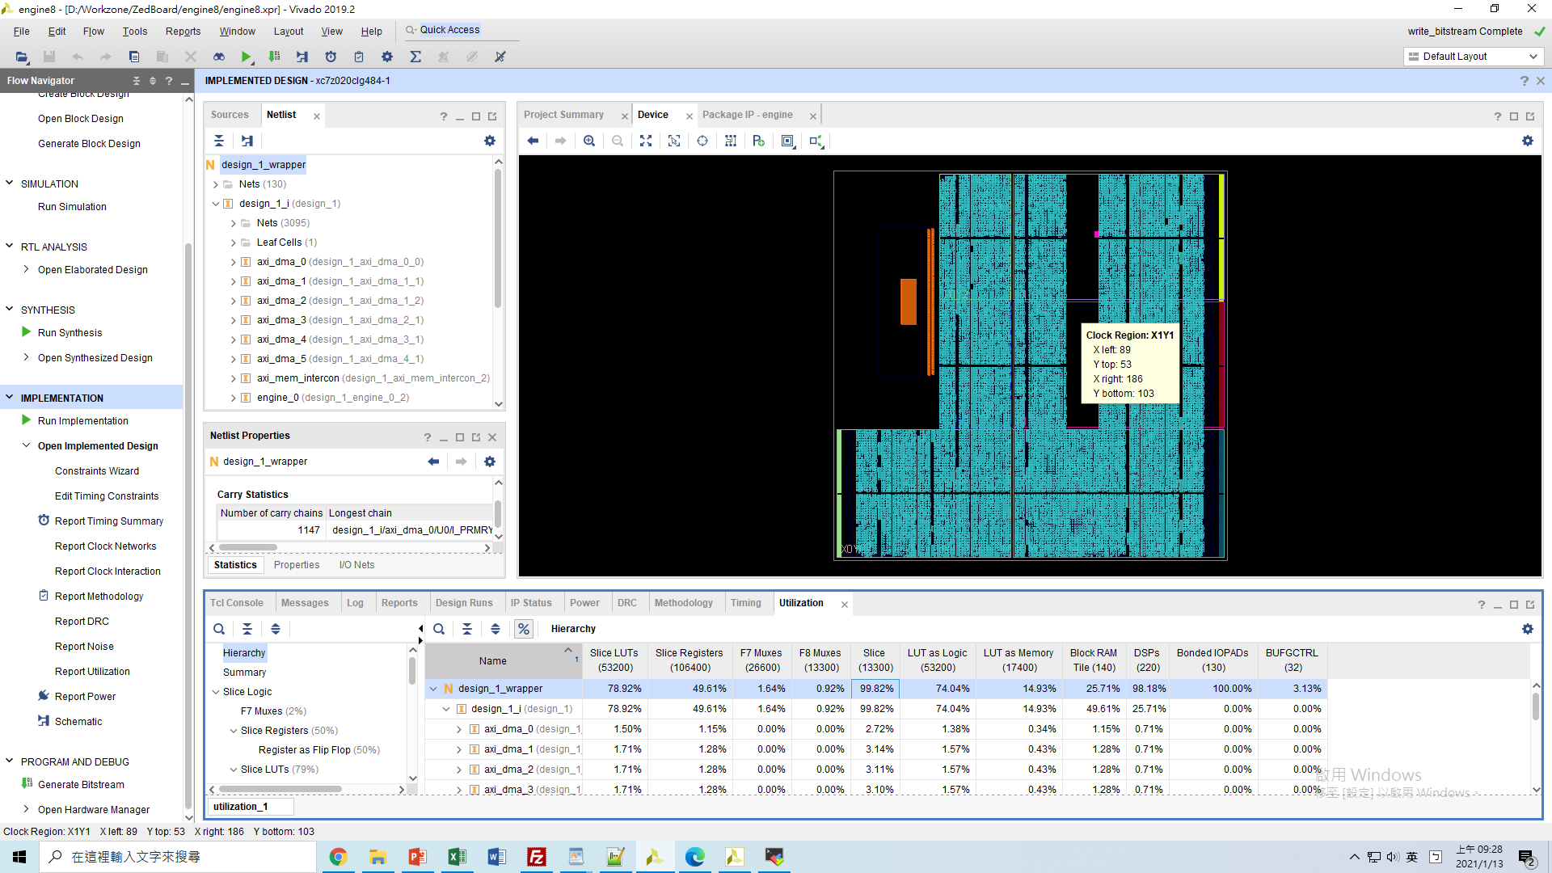

Slide 17
µ-archi. & Optimization

Slide 18
µ-archi.
Purposed of Pragma used
System Level: Non-blocing Access
Module Level: Mersenne Twister
Module Level: ICDF
Module Level: Heston
Analyze
Scheduling of buffer transfer, kernel execution
throughput

Slide 19
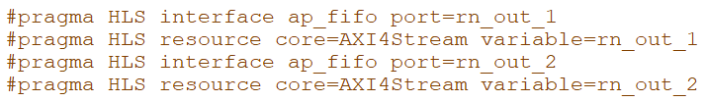
Key Design: Non-Blocking Access
Four modules can operate at the same time. The idea is similar to dataflow between functions, but between ip blocks. Blocking access like AXIS or AXI master are not suitable.
Ap_fifo enables non-blocking access. RNG can output numbers to fifo, and Heston module can retrieve data from fifo without communication through any protocols.
Antithetic doubles the data rate, fifo should be full the whole time, so empty is not an issue.
The order of RNs does not matter. Excessive numbers can be dropped, so full is also not an issue.

Slide 20
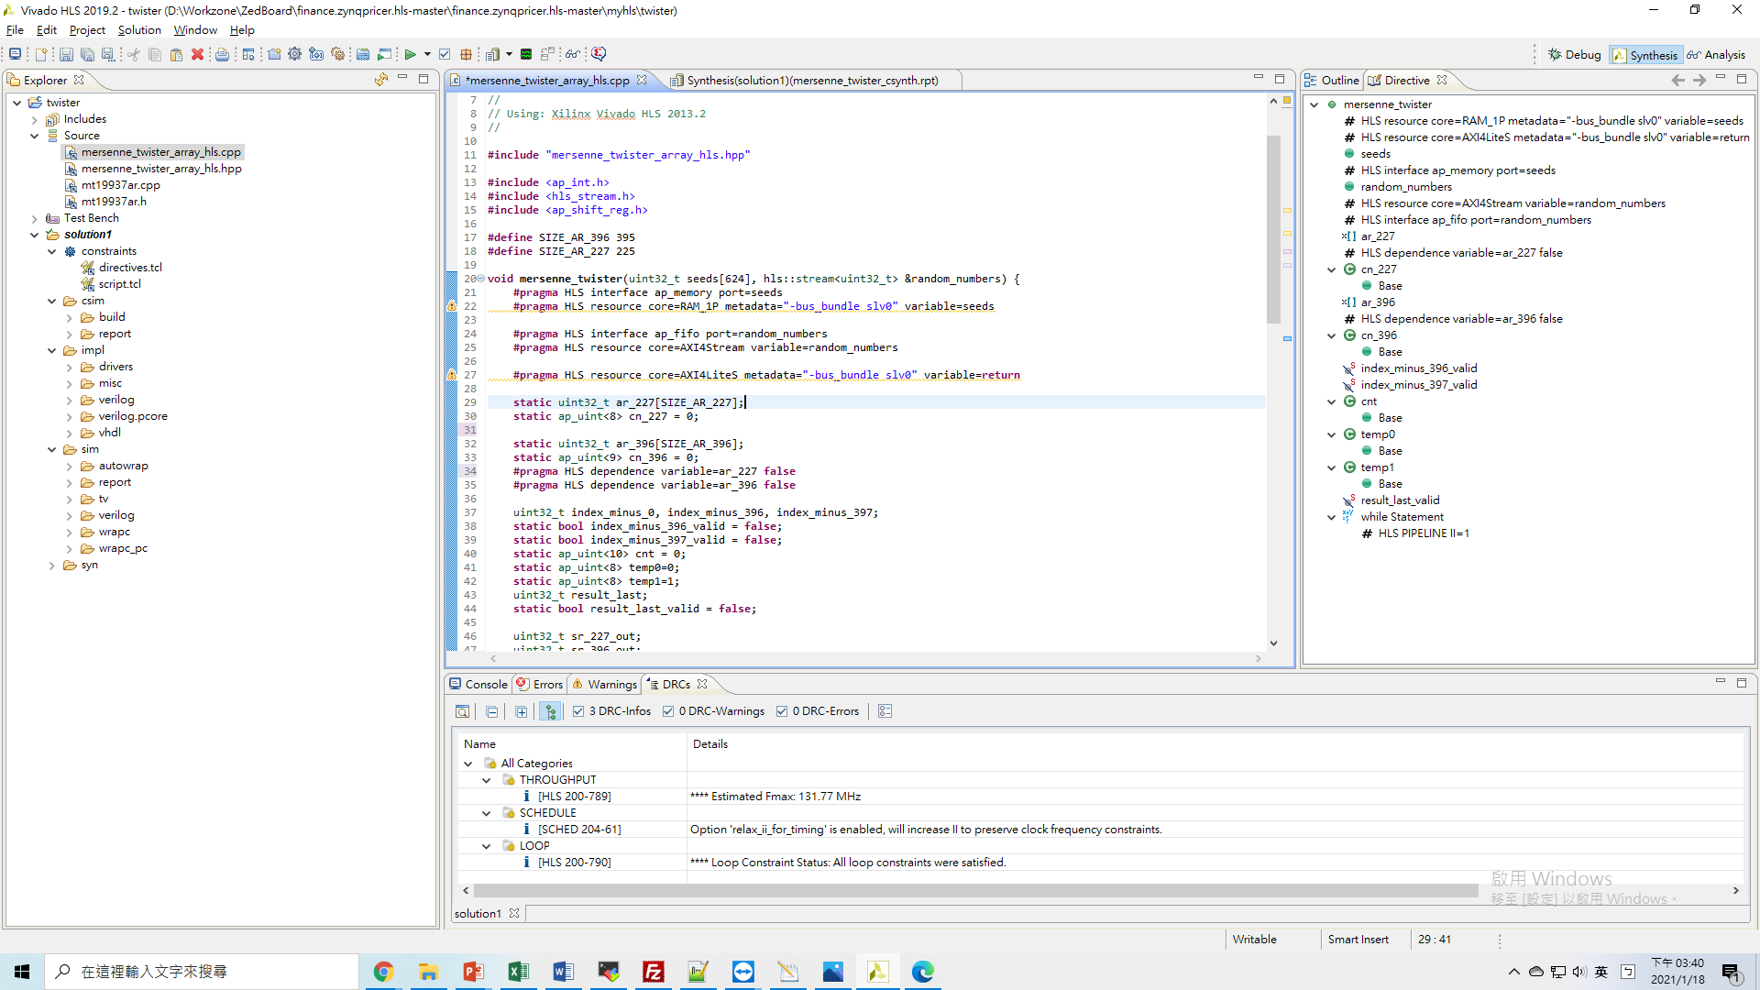
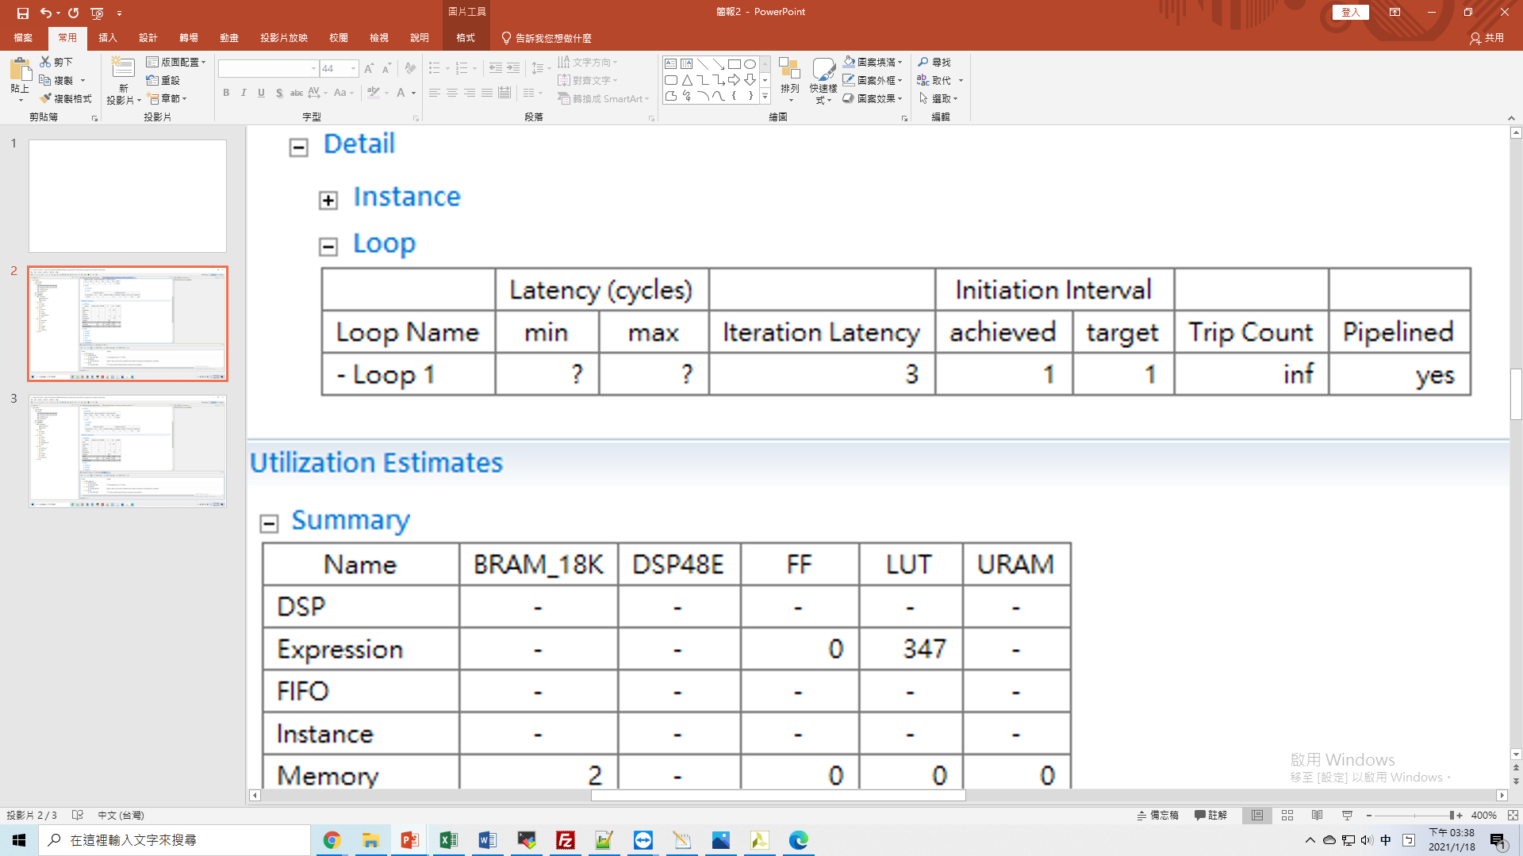
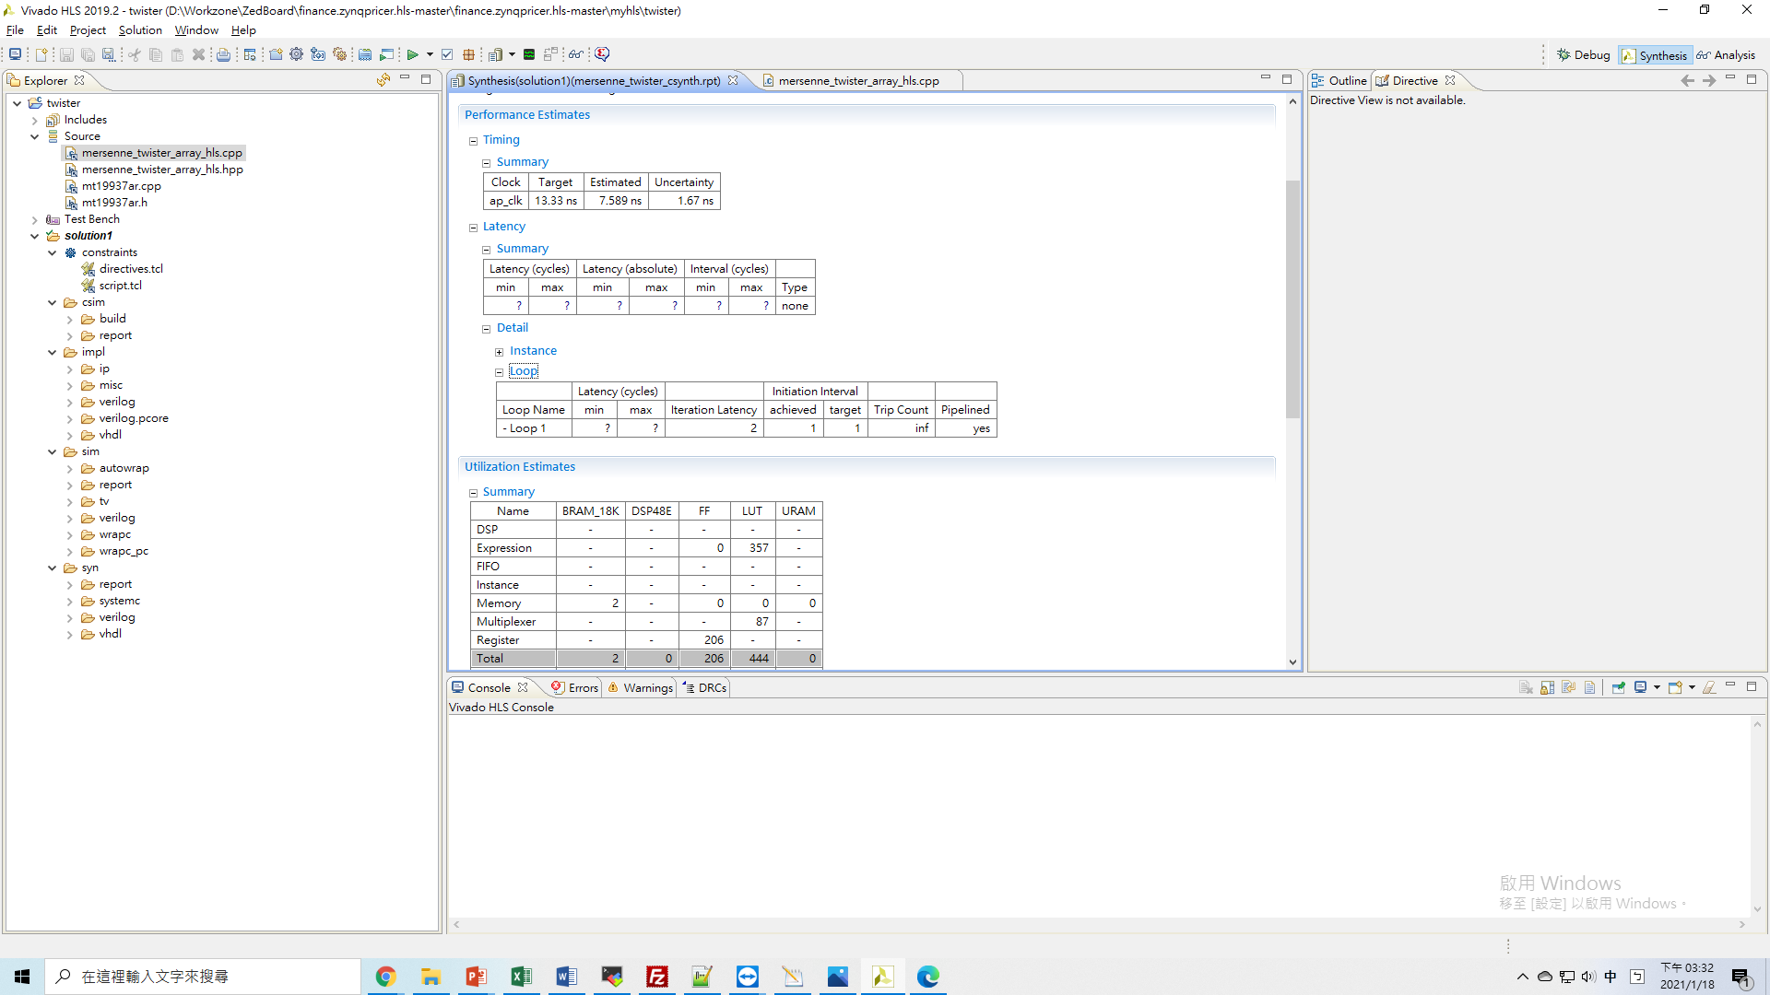
Mersenne Twister
Use two 1D arrays to store intermediate products.
Arrays are accessed sequentially. In each iteration, only one element from each array is used.
Set loop dependency=False to enable more efficient pipeline, although the improvement is minor.

Slide 21
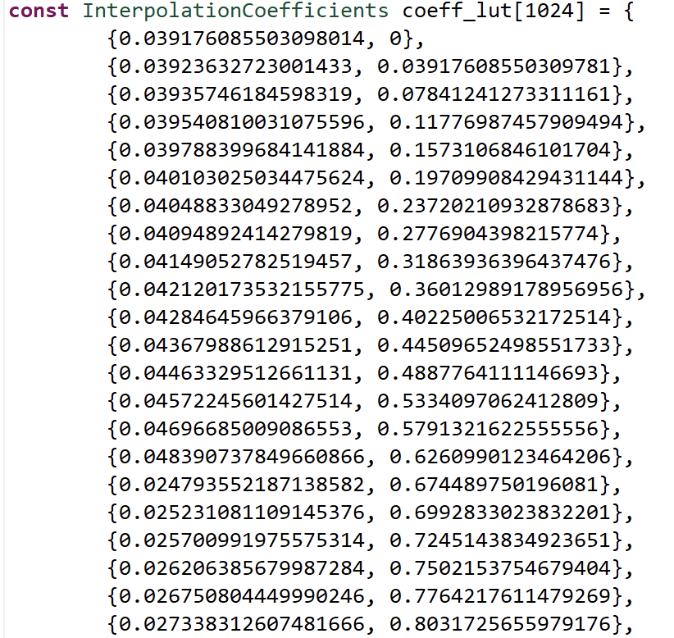
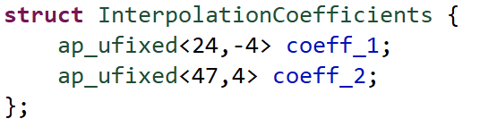
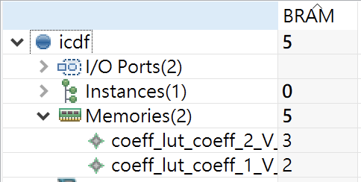
ICDF
Using 2 ap_fixed to represent coeff
Requires 5 BRAM to accomodate them

Slide 22
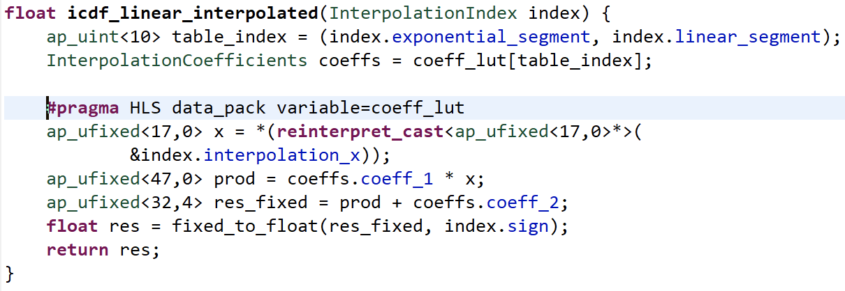
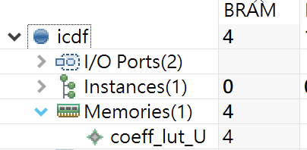
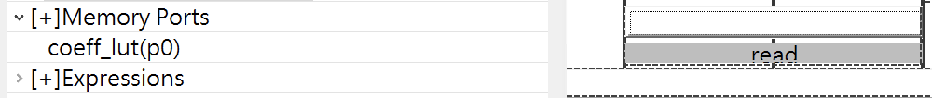
ICDF
Read Port of BRAM is 72 bit
Using DATA_PACK to pack them into the same BRAM line
Reduced BRAM by 20%

Slide 23
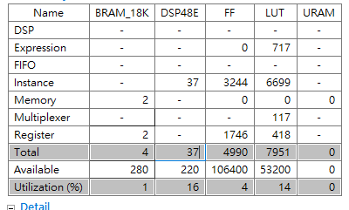
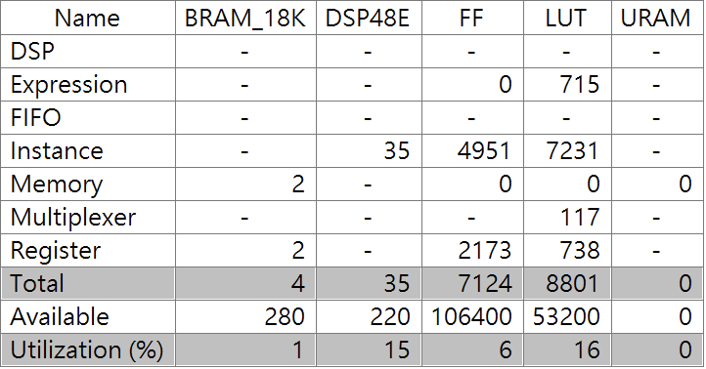
Heston
DSP Util. keeps us from adding one more engine

Slide 24
Heston
DSP Util. keeps us from adding one more engine

Slide 25
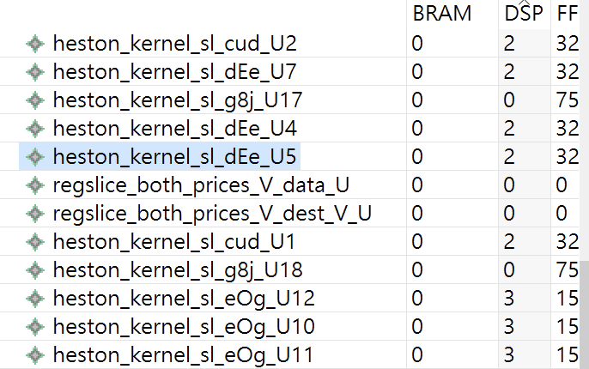
Heston
Analyze DSP Usage in Heston
Floating Point Add/Sub takes 2 DSP
Floating Point Mul takes 3 DSP

Slide 26
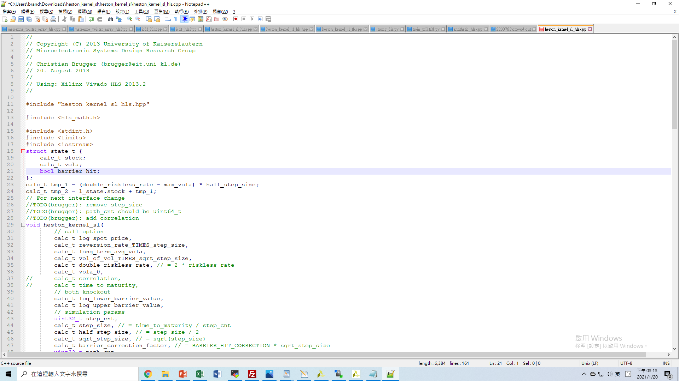
Heston
Analyze DSP Usage in Heston
Manipulate Directives to specify not to use DSP
Reduced by 8.6%

Slide 27
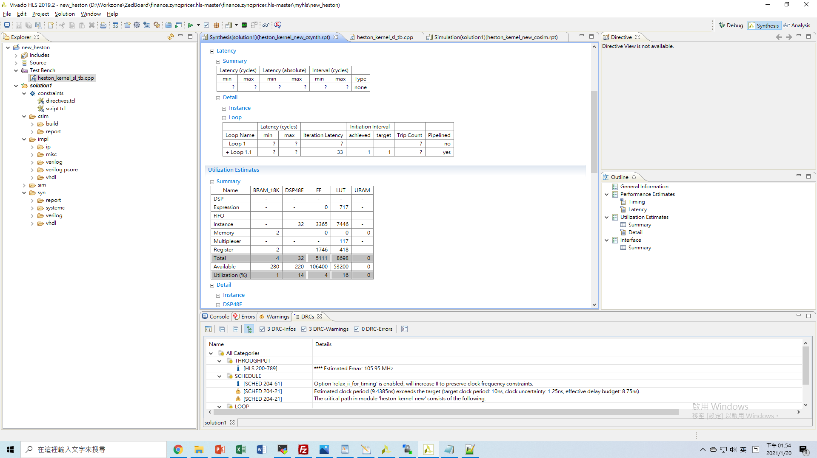
Heston
Analyze DSP Usage in Heston
DSP Util. Reduced by 8.6%
However, once LUT Utll. > 90%, congestion will happen
Still not enough to add one more engine

Slide 28
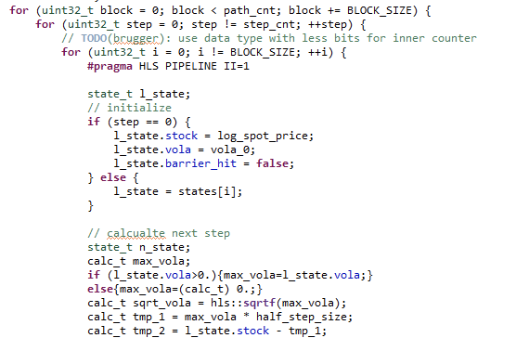
A “crippled” version of Heston engine
Loosen II limitation can significantly reduce resource usage.

Slide 29
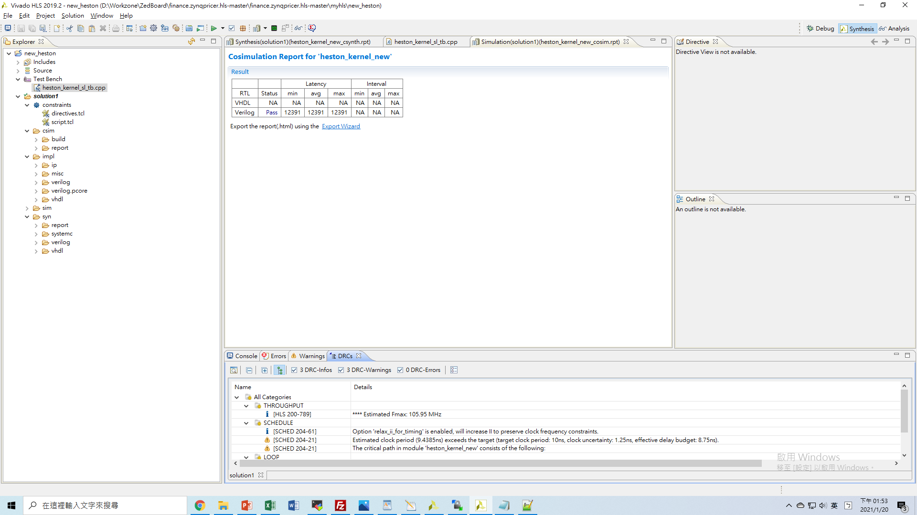
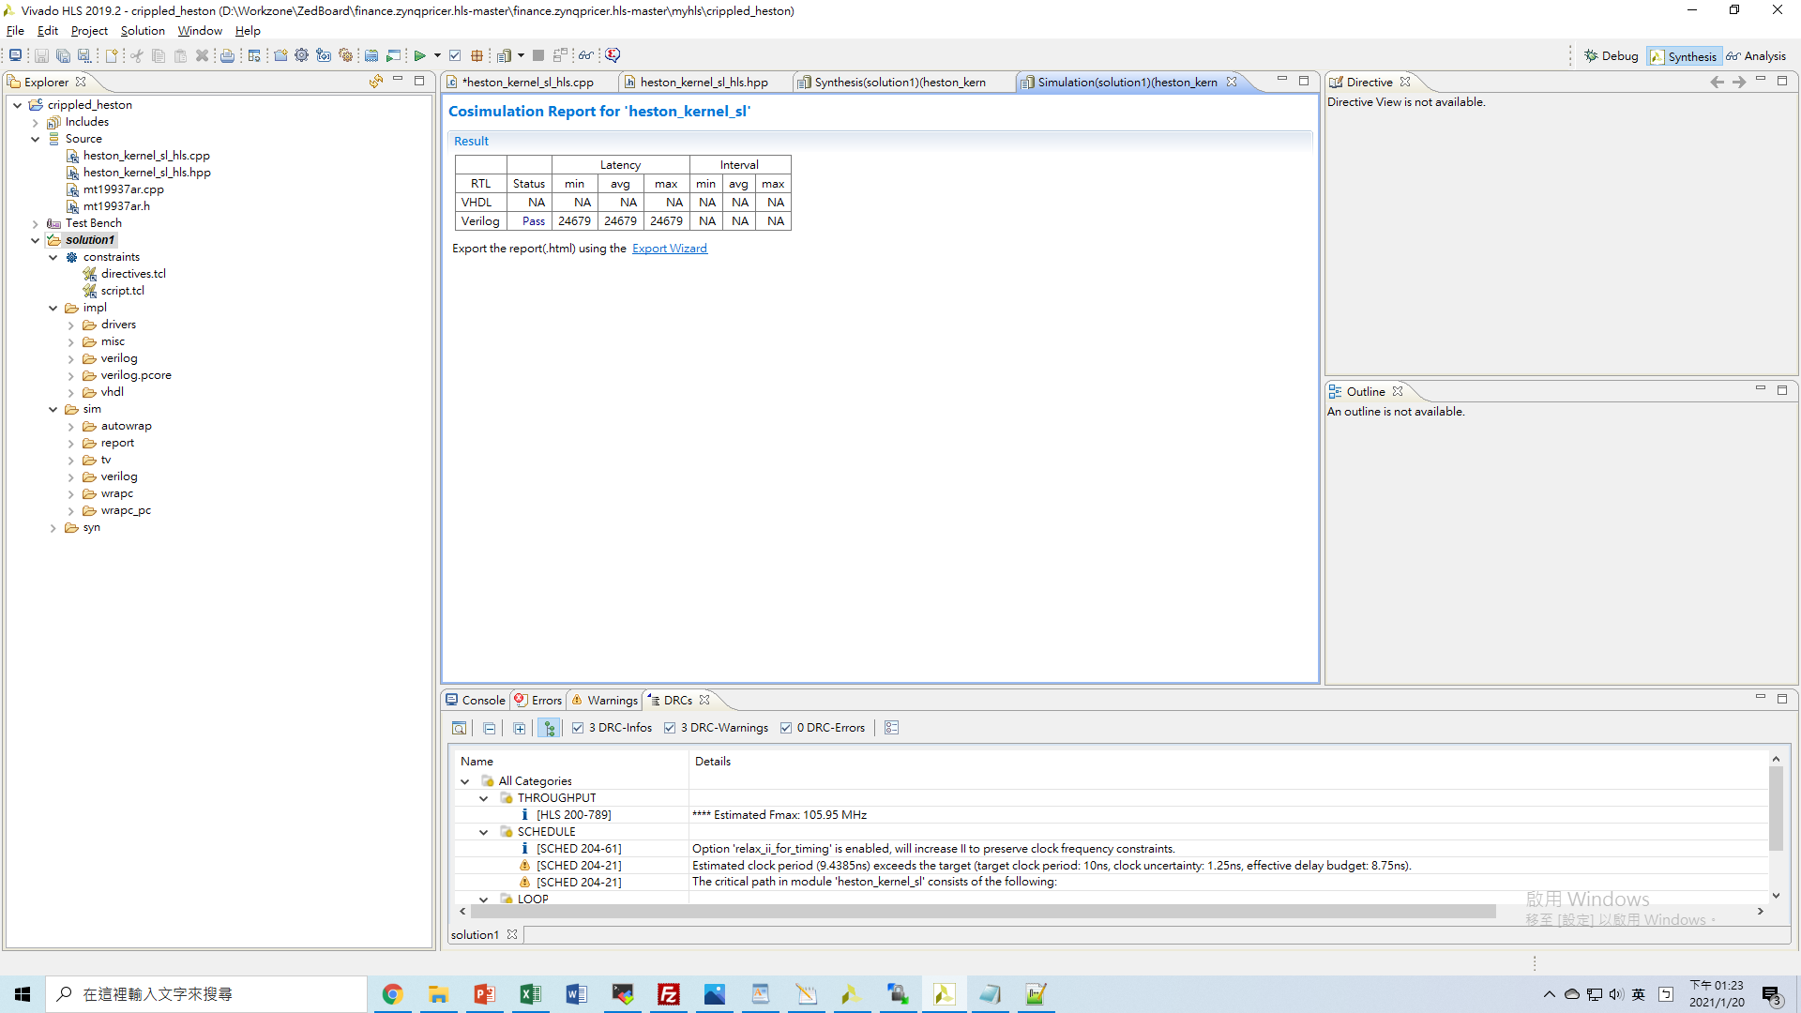
A “crippled” version of Heston engine
Setting II=2 can significantly reduce resource usage.

Slide 30
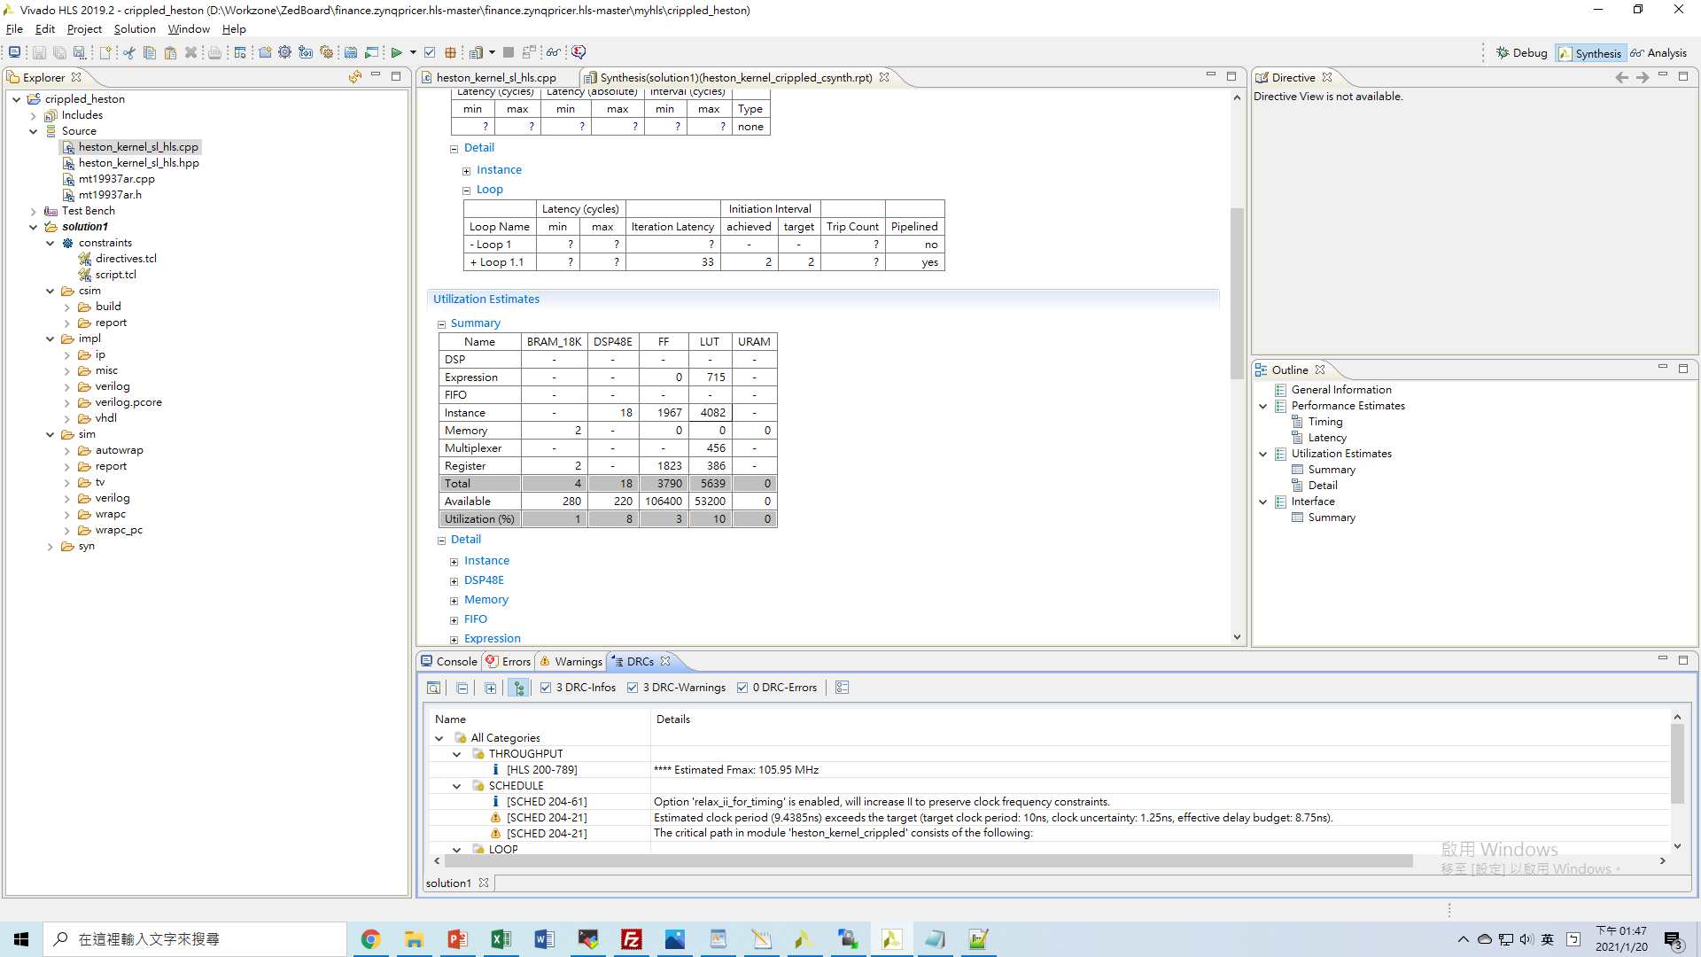
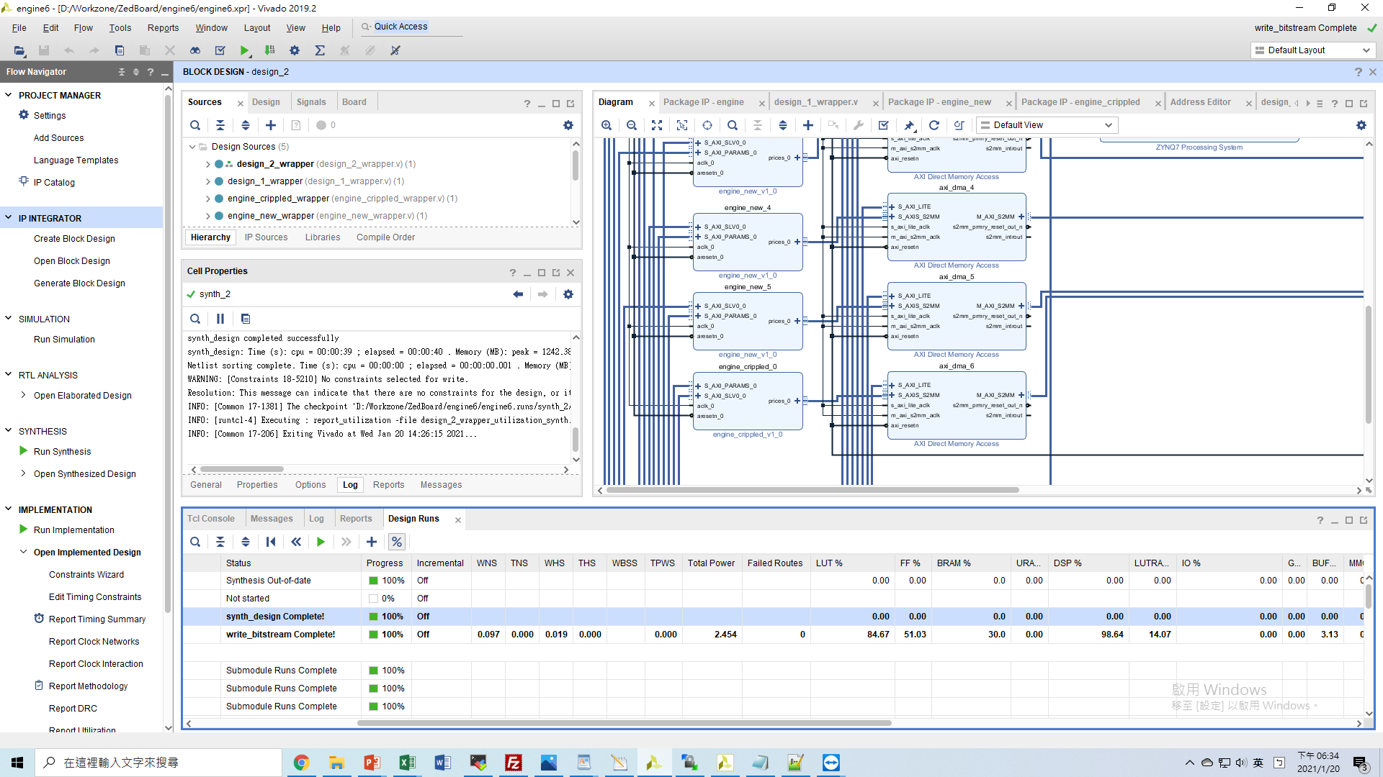
A “crippled” version of Heston engine
33*6+19=217 DSP
Implemented on Pynq

Slide 31
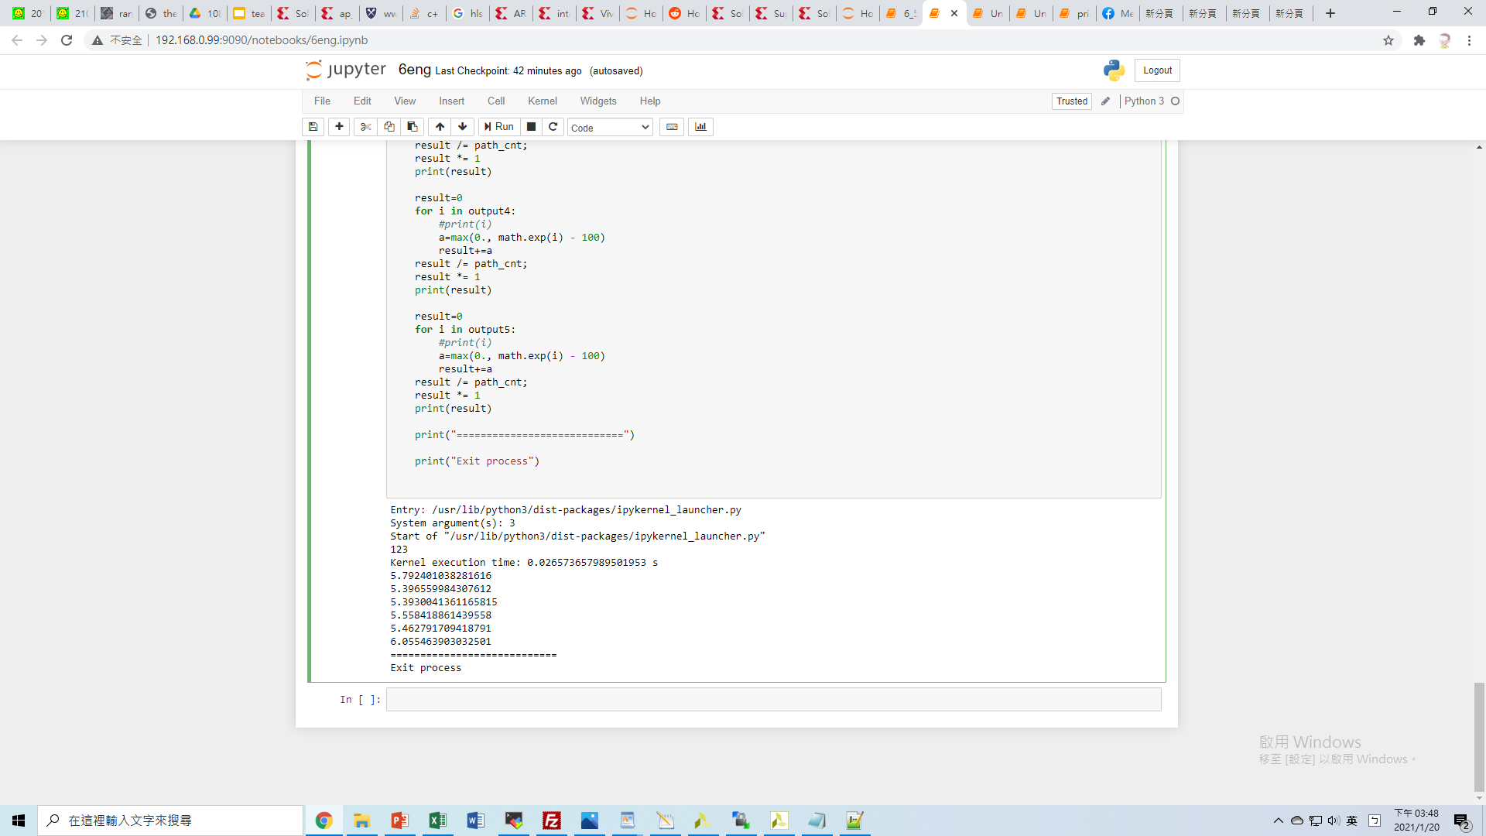
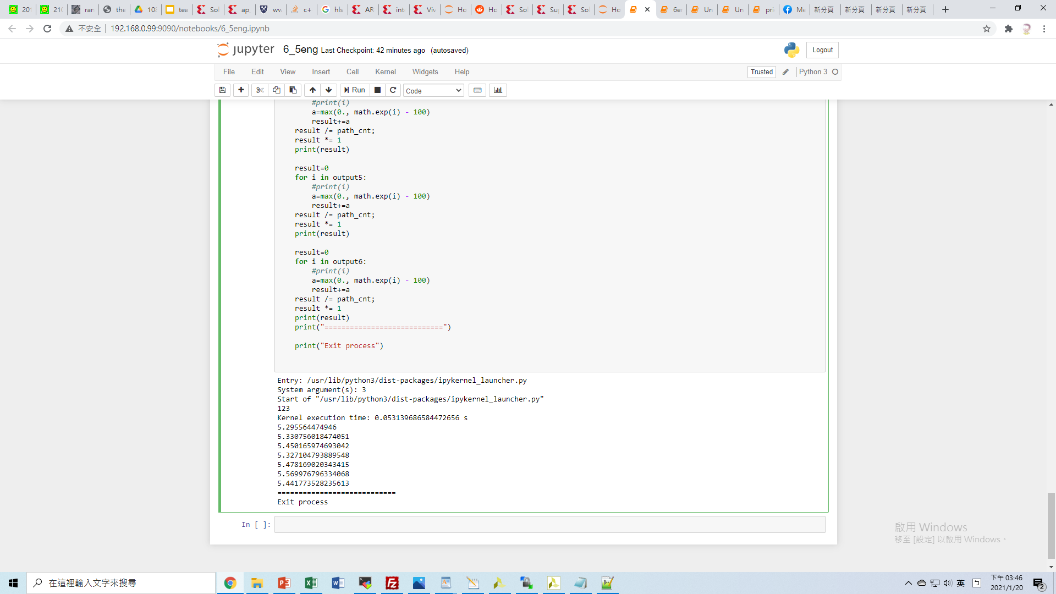
Improvement
Original implementation:
(2560000 steps_per_trigger * 6 eng_triggers)/0.0266 seconds=5.78e+08 steps/seconds
Improved implementation:
(2560000 steps_per_trigger * 13 eng_triggers)/0.0531 seconds=6.26e+08 steps/seconds
8.3% performance improvement

Slide 32
Analysis
Scheduling (Before)
Throughput
(10000 simulations_per_trigger * 6 triggers) / 0.0266 seconds
=2.26e+06 simulations/sec
Host(SW)
initialize all engs
retrieve data from normal engs
normal_eng
compute

Slide 33
Analysis
Scheduling (After)
Throughput
(10000 simulations_per_trigger * 13 triggers) / 0.0531 seconds
=2.45e+06 simulations/sec
Host(SW)
initialize all engs
retrieve data from normal engs
re-trigger normal engs
retrieve data from all engs
normal_eng
compute
compute
crippled_eng
compute

Slide 34
Thanks for Listening!

